Slide 1

INFM 603: Information Technology and Organizational Context
Session 1: Physical and Web Infrastructure
Jimmy Lin
The iSchool University of Maryland
Wednesday, January 29, 2014

Slide 2
Introduction (How I got here)

Slide 3


From the Ivory Tower…
Source: Wikipedia (All Souls College, Oxford)

Slide 4
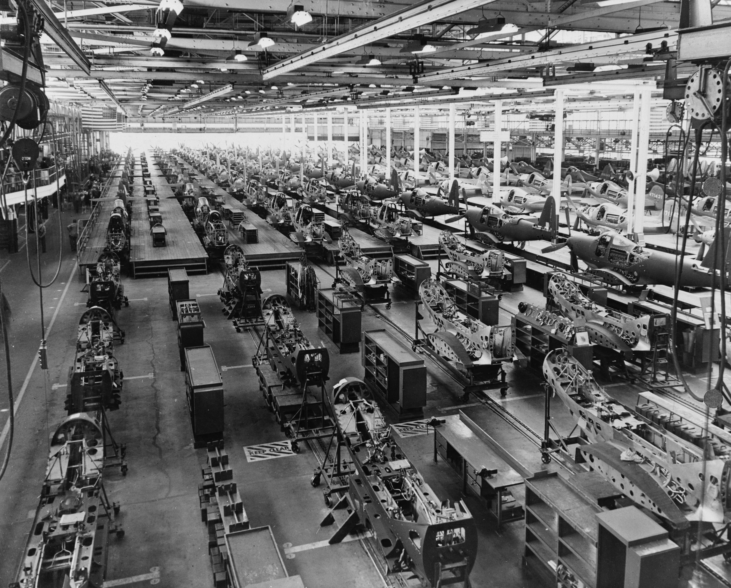

… to building sh*t that works
Source: Wikipedia (Factory)

Slide 5
… and back.
Source: Wikipedia (All Souls College, Oxford)

Slide 6
Introduction (How you got here)

Slide 7
This course is about programming
(but the goal is not to make you into a programmer)

Slide 8
The key to surviving technology?

Slide 9

Agility
Source: Wikipedia (Cheetah

Slide 10
A brief history… (How computing got here)

Slide 11
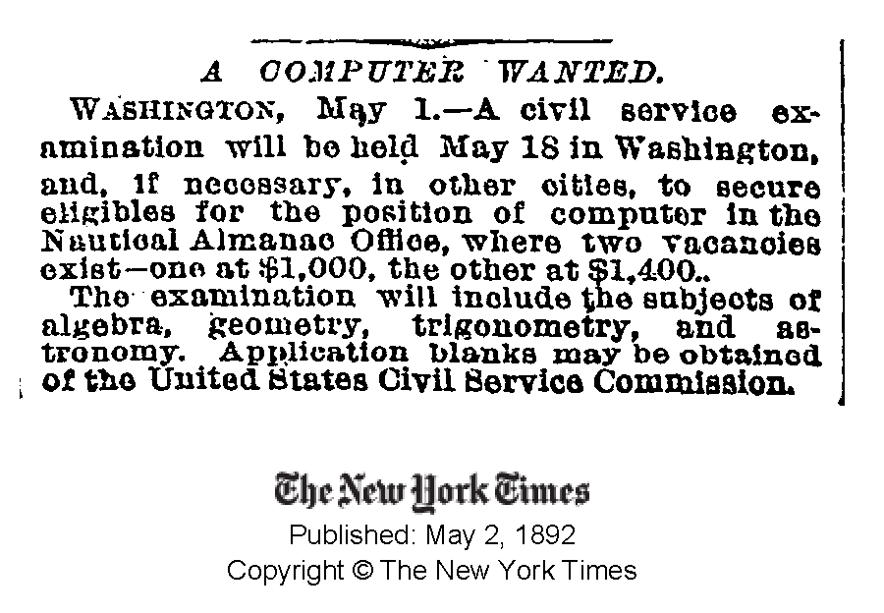

Slide 12
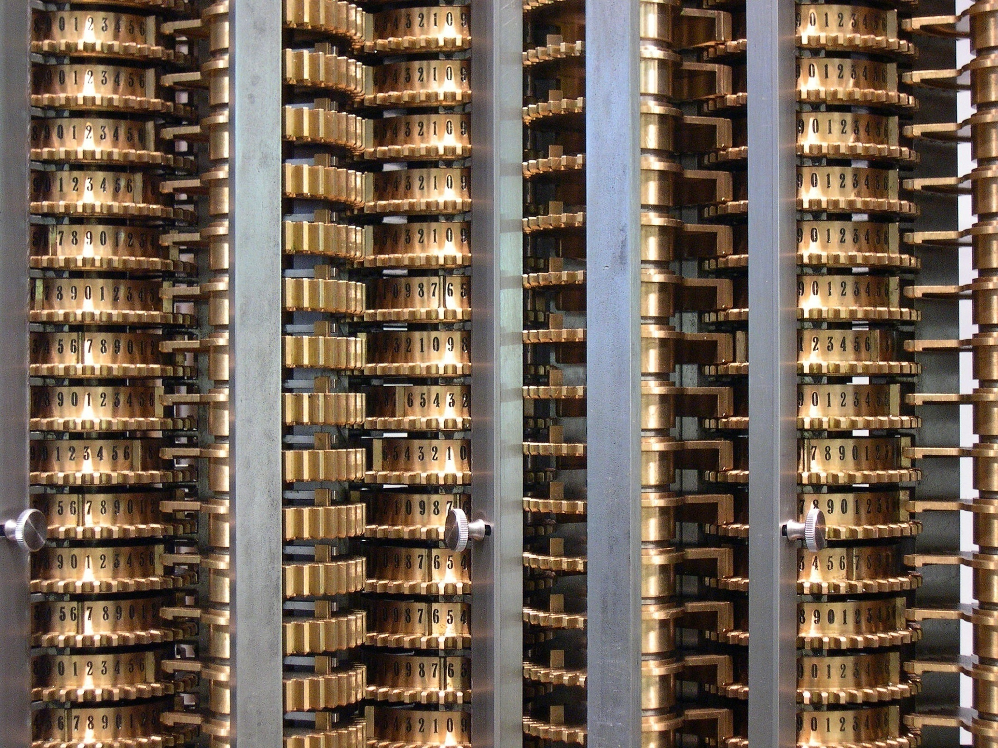
Source: Wikipedia (Difference engine)

Slide 13

Source: Wikipedia (ENIAC)

Slide 14
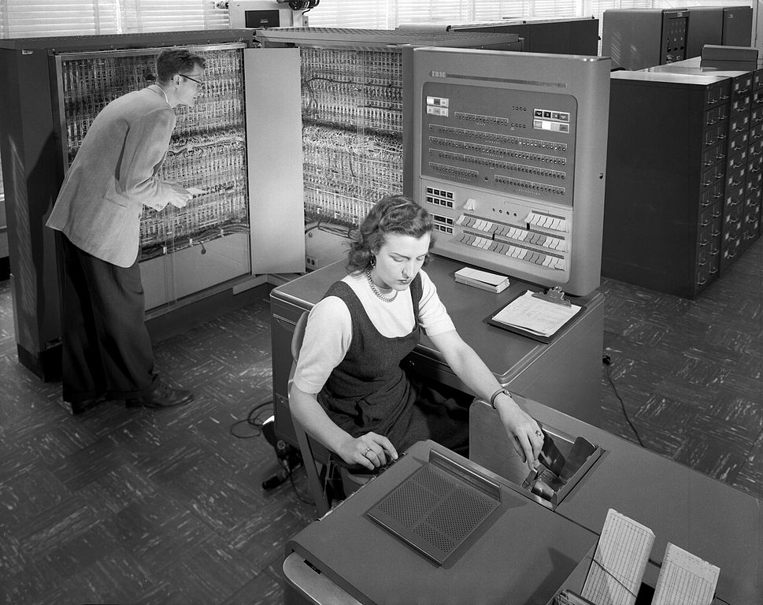
Source: Wikipedia (IBM 704)

Slide 15
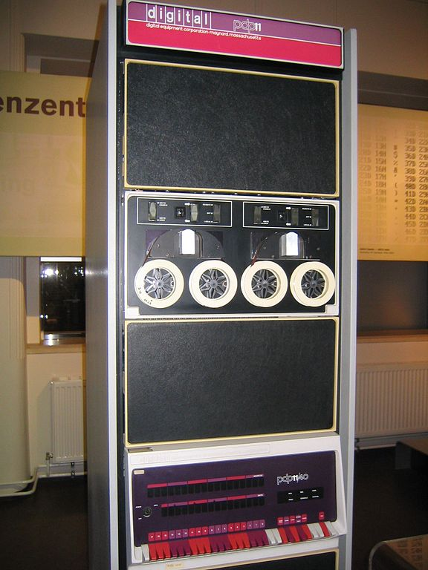
Source: Wikipedia
Source: Wikipedia (PDP-11)

Slide 16

Source: Wikipedia (Personal computer)

Slide 17

Source: Wikipedia

Slide 18
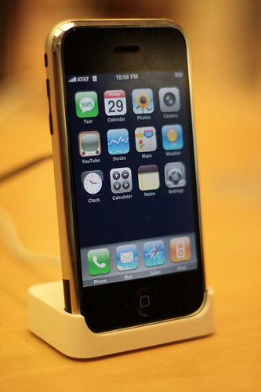
Source: Wikipedia

Slide 19
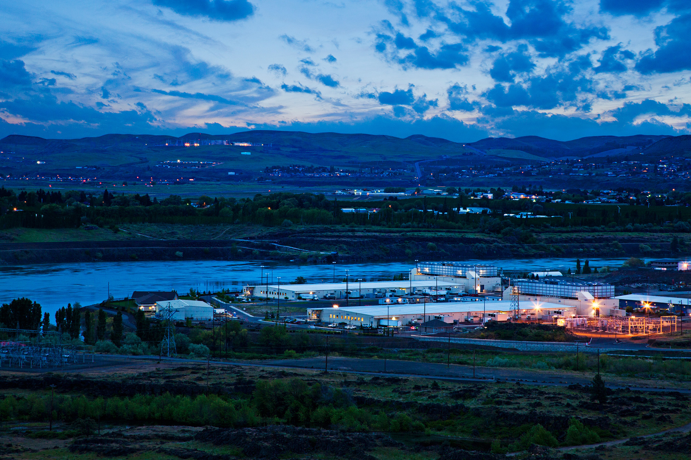
Source: Google

Slide 20
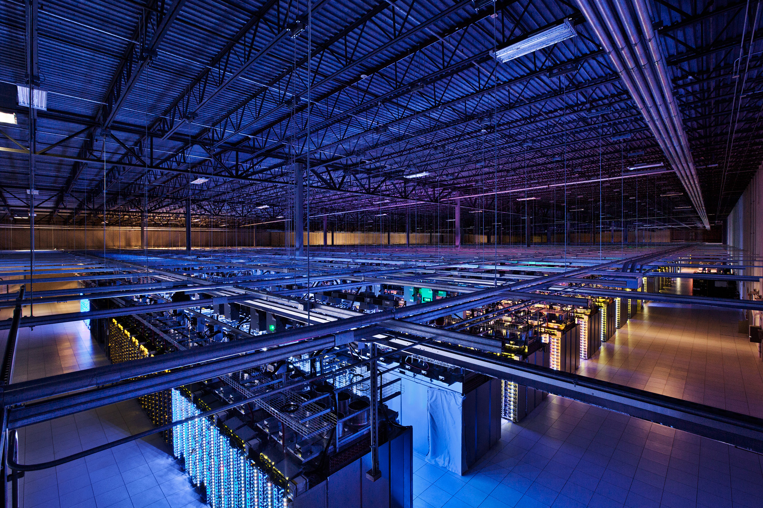
Source: Google

Slide 21
What is a computer?
Memory
Processor
Output
Input

Slide 22
The Processing Cycle
Input comes from somewhere
Keyboard, mouse, touchpad, touch screen, microphone, camera, …
Fetch data from memory
The computer does something with it
Add, subtract, multiply, etc.
Output goes somewhere
Monitor, speaker, printer, robot controls, …
Store data back into memory

Slide 23
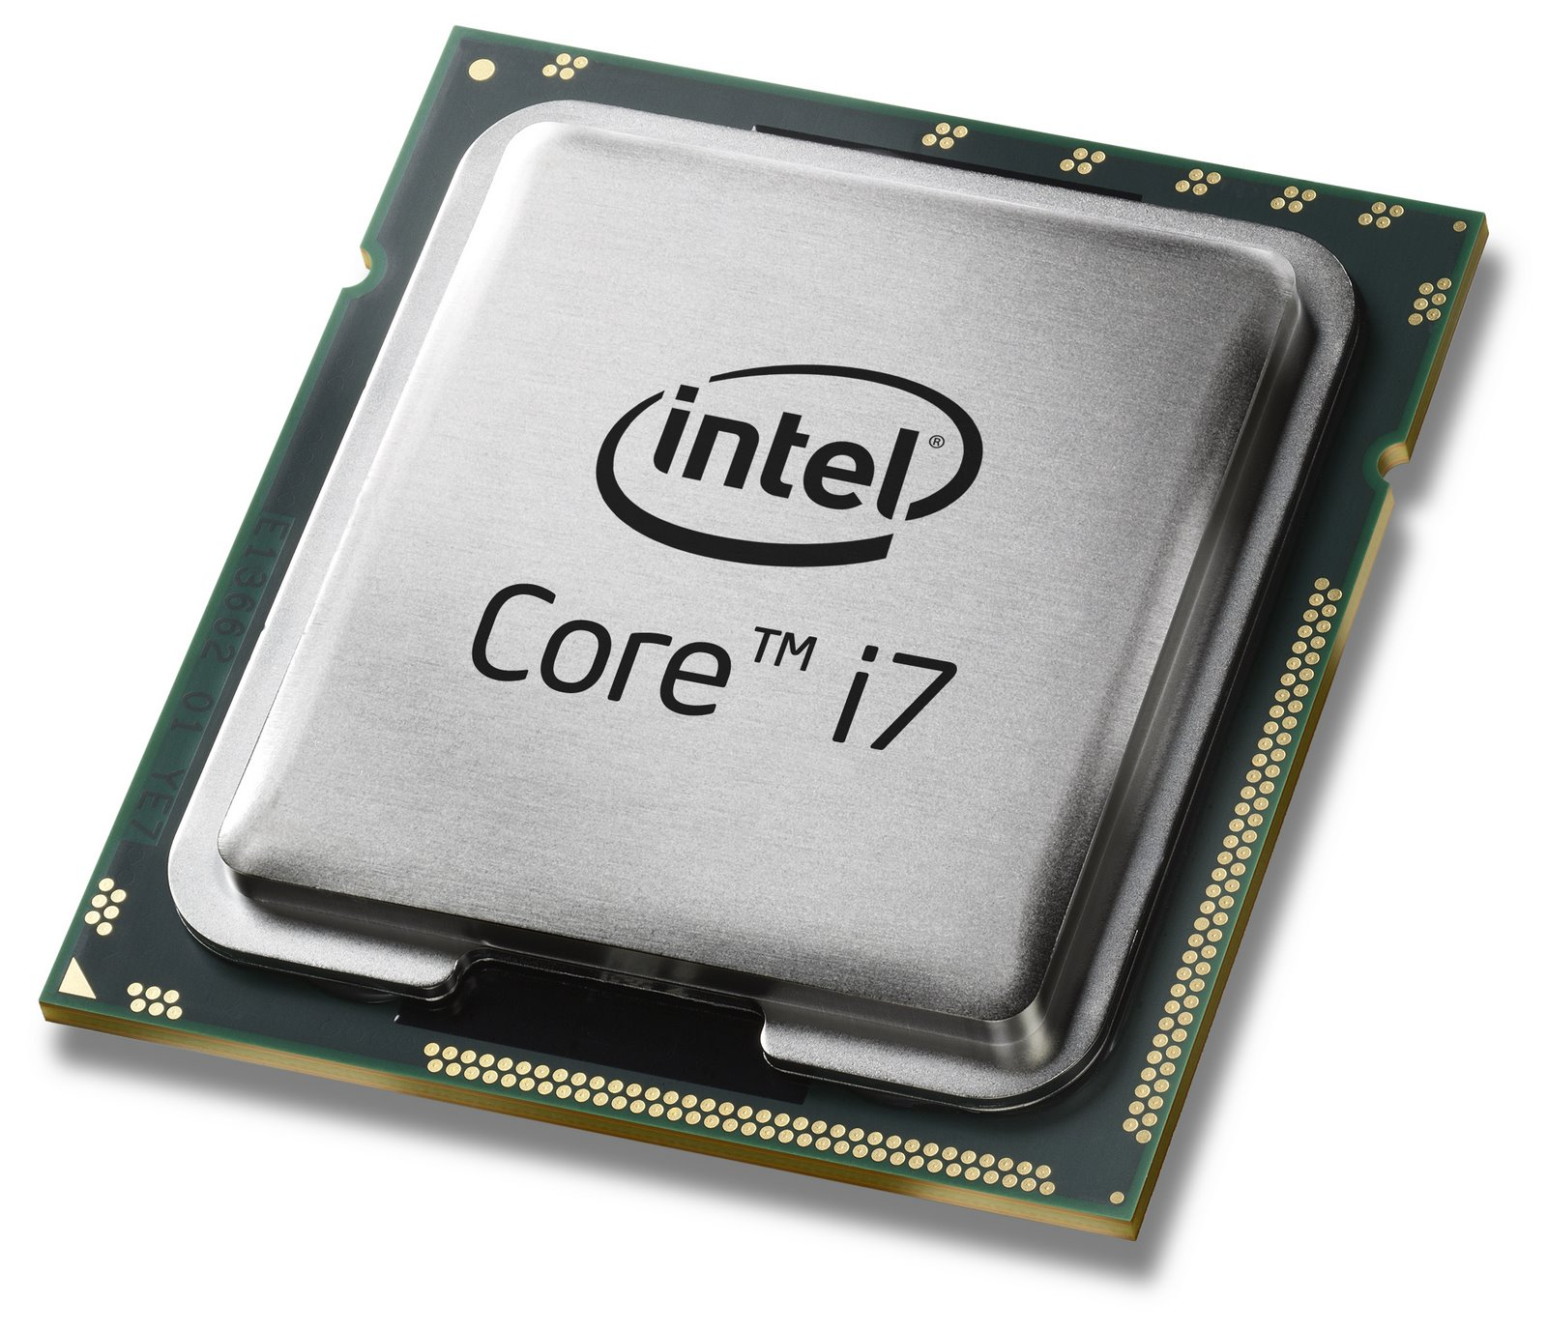
Source: Intel

Slide 24
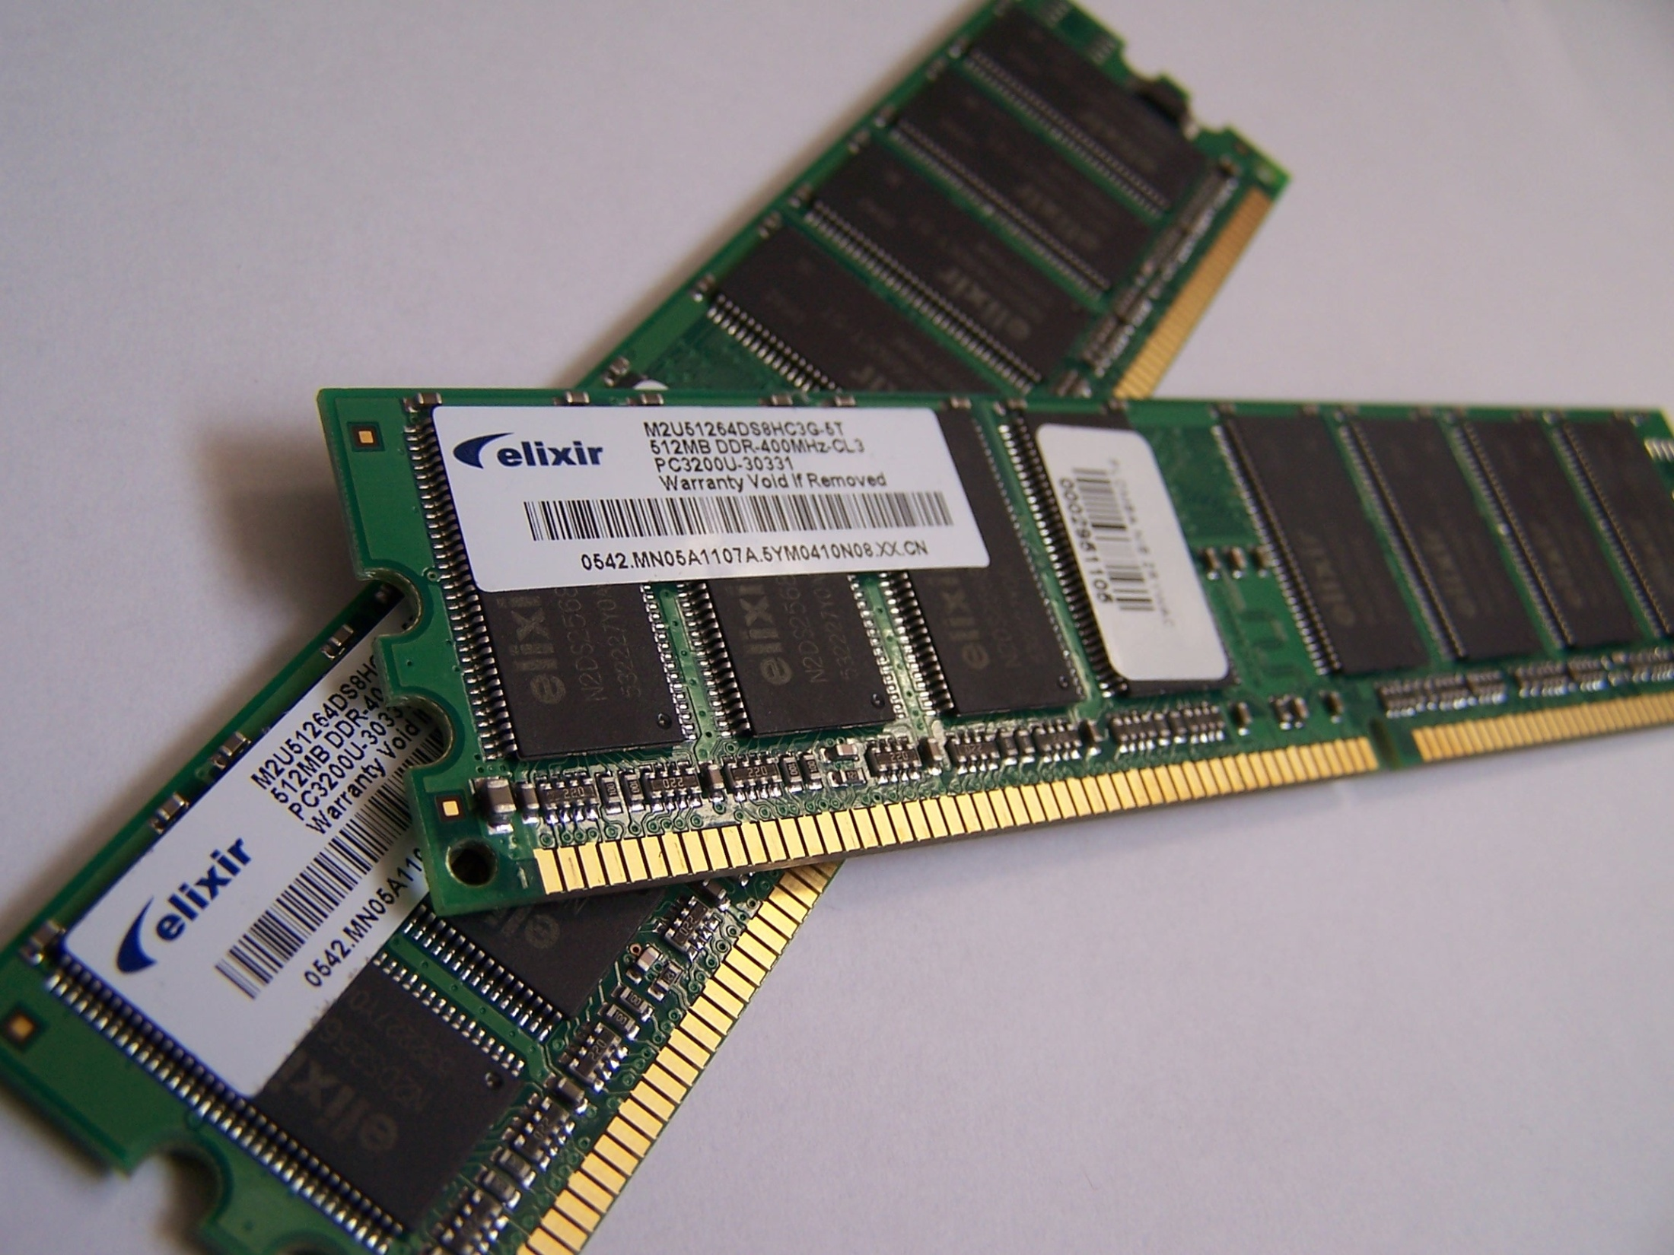
Source: Wikipedia (Random-access memory)

Slide 25
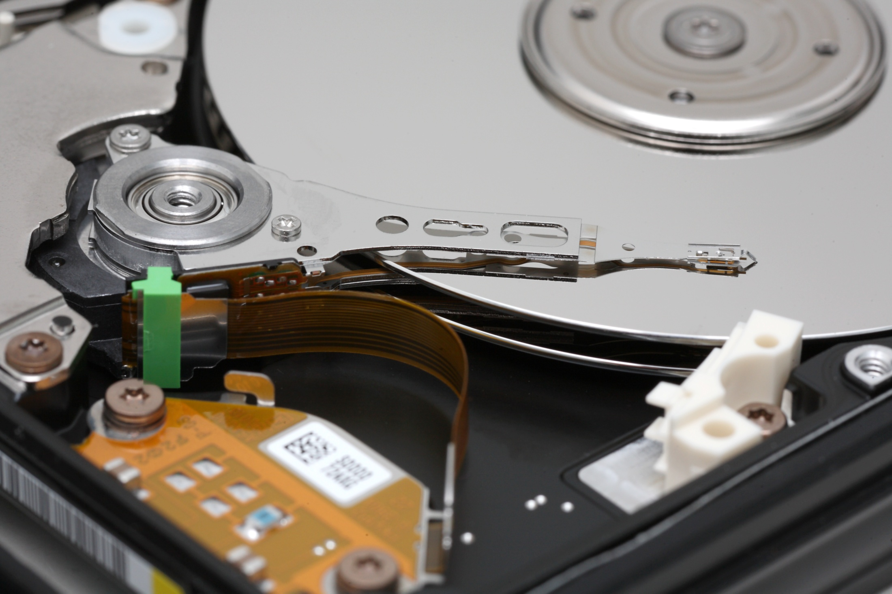
Source: Wikipedia

Slide 26
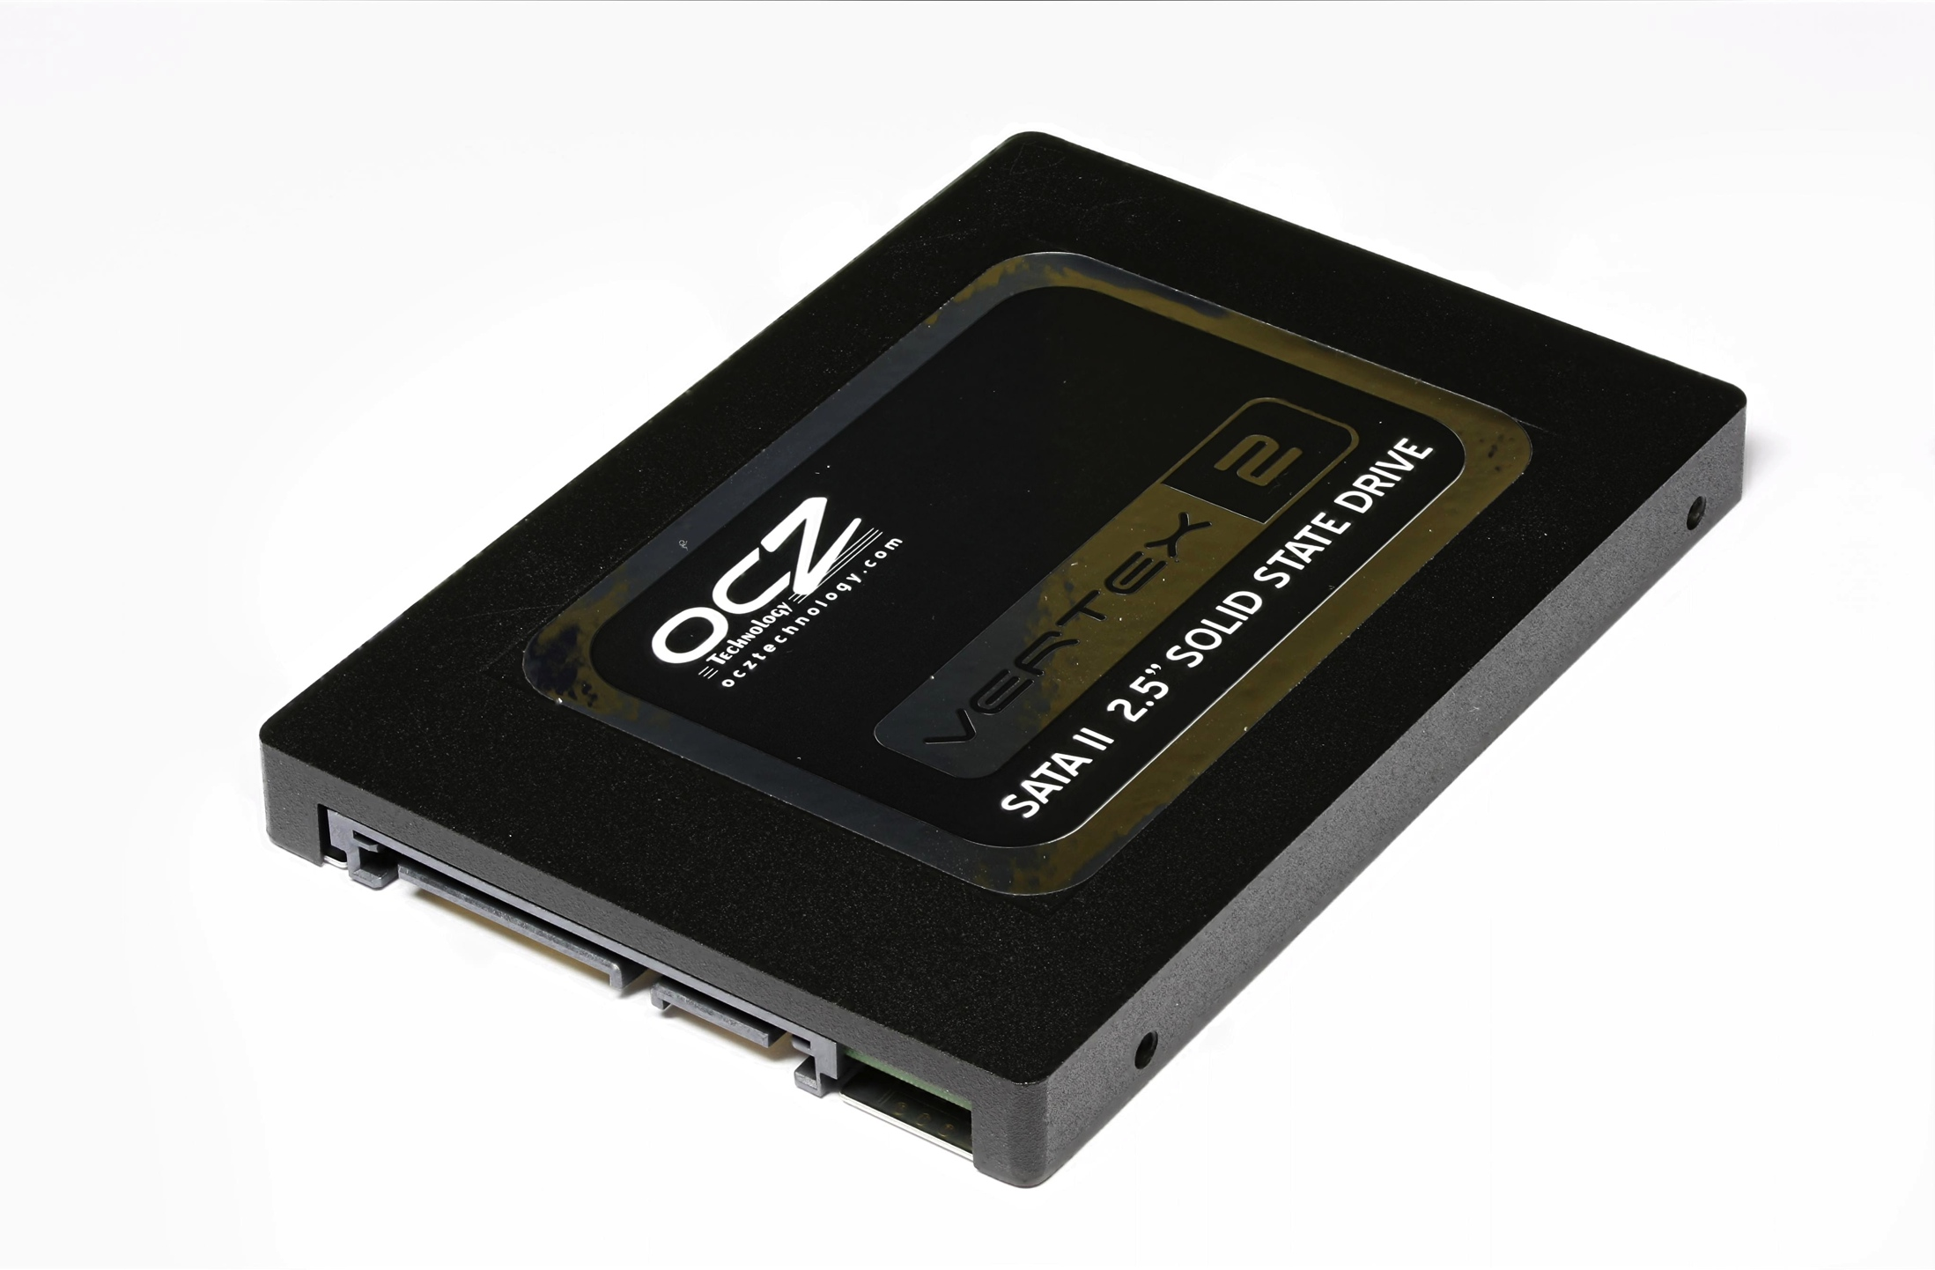
Source: Solid-state drive

Slide 27
Networking

Slide 28
Why Networking?
Sharing data
Sharing hardware
Sharing software
Increasing robustness
Facilitating communications
Facilitating commerce

Slide 29
How did it all start?
How did it evolve?
How did we get here?

Slide 30
Packet vs. Circuit Networks
Telephone system (“circuit-switched”)
Fixed connection between caller and called
High network load results in busy signals
Internet (“packet-switched”)
Each transmission is broken up into pieces and routed separately
High network load results in long delays

Slide 31
Packet Switching
Break long messages into short “packets”
Keeps one user from hogging a line
Each packet is tagged with where it’s going
Route each packet separately
Each packet often takes a different route
Packets often arrive out of order
Receiver must reconstruct original message
How do packet-switched networks deal with continuous data?
What happens when packets are lost?

Slide 32
Different Networks Types
Local Area Networks (LANs)
Connections within a building or a small area
Wireless or wired
Wide Area Networks (WANs)
Connections between multiple LANs
May cover thousands of square miles
The Internet
Collection of WANs across multiple organizations

Slide 33
The Internet
Global collection of public networks
Private networks are often called “intranets”
Use of shared protocols
TCP/IP (Transmission Control Protocol/Internet Protocol): basis for communication
DNS (Domain Name Service): basis for naming computers on the network
HTTP (HyperText Transfer Protocol): World Wide Web
Next week: how does all of this work?

Slide 34
Characterizing Computing

Slide 35
Trends in Computing: #1

Slide 36
Trends in Computing: #2

Slide 37
Trends in Computing: #3

Slide 38
Ways to characterize computing
How big?
How fast?
How reliable?
Computing is fundamentally about tradeoffs!

Slide 39
How big?

Slide 40


Slide 43
How many states can n bits represent?
(or the story of 18,446,744,073,709,551,615 grains of rice)

Slide 44


Slide 45
Data is represented via an encoding
American Standard Code for Information Interchange (ASCII)
= standard byte encoding used in PC’s
01000001 = A
01000010 = B
01000011 = C
01000100 = D
01000101 = E
01000110 = F
01000111 = G
01001000 = H
01001001 = I
01001010 = J
01001011 = K
01001100 = L
01001101 = M
01001110 = N
01001111 = O
01010000 = P
01010001 = Q
…
01100001 = a
01100010 = b
01100011 = c
01100100 = d
01100101 = e
01100110 = f
01100111 = g
01101000 = h
01101001 = i
01101010 = j
01101011 = k
01101100 = l
01101101 = m
01101110 = n
01101111 = o
01110000 = p
01110001 = q
…

Slide 46
Units of Size
Unit | Abbreviation | Size (bytes)
bit | b | 1/8
byte | B | 1
kilobyte | KB | 2¹⁰ = 1,024
megabyte | MB | 2²⁰ = 1,048,576
gigabyte | GB | 2³⁰ = 1,073,741,824
terabyte | TB | 2⁴⁰ = 1,099,511,627,776
petabyte | PB | 2⁵⁰ = 1,125,899,906,842,624
In most cases, it’s okay to approximate!

Slide 47
How small?

Slide 48
Units of Distance
Unit | Abbreviation | Fraction of a meter
meter | m | 1
centimeter | cm | 10⁻² = 1/100
millimeter | mm | 10⁻³ = 1/1,000
micrometer | μm | 10⁻⁶ = 1/1,000,000
nanometer | nm | 10⁻⁹ = 1/1,000,000,000
picometer | pm | 10⁻¹² = 1/1,000,000,000,000

Slide 49
Progression of Technology
Year | Feature Size
1971 | 10 μm
1975 | 3 μm
1982 | 1.5 μm
1985 | 1 μm
1989 | 800 nm
1994 | 600 nm
1995 | 350 nm
1997 | 250 nm
1999 | 180 nm
2002 | 130 nm
2004 | 90 nm
2006 | 65 nm
2008 | 45 nm
2010 | 32 nm
2012 | 22 nm
How large is a silicon atom?
~0.25 nm

Slide 50
How fast?

Slide 51
Thinking About Speed
Speed can be expressed in two ways:
How many things can you do in one second?
How long to do something once?
Convenient units are typically used
1 GHz instead of 1,000,000,000 Hz
10 microseconds rather than 0.00001 seconds
When comparing measurements, convert units first!

Slide 52
Units of Frequency
Unit | Abbreviation | Cycles per second
hertz | Hz | 1
kilohertz | KHz | 10³ = 1,000
megahertz | MHz | 10⁶ = 1,000,000
gigahertz | GHz | 10⁹ = 1,000,000,000

Slide 53
Units of Time
Unit | Abbreviation | Duration (seconds)
second | sec/s | 1
millisecond | ms | 10⁻³ = 1/1,000
microsecond | μs | 10⁻⁶ = 1/1,000,000
nanosecond | ns | 10⁻⁹ = 1/1,000,000,000
picosecond | ps | 10⁻¹² = 1/1,000,000,000,000
femtosecond | fs | 10⁻¹⁵ = 1/1,000,000,000,000,000
How far does light travel in one nanosecond?
0.3048 m

Slide 54
How fast can we compute?
Computation speed is limited by two factors:
Getting data to the CPU
Operating on the data in the CPU
Two parts of moving data from here to there:
The delay between two locations
Amount of data you can move within a given amount of time
Fundamentally, there’s no difference:
Moving data from the processor to RAM
Saving a file to disk
Watching Netflix

Slide 55
Latency
Units in terms of time
Bandwidth
Units in terms of size per time

Slide 56
Discussion Point
What’s more important: latency or bandwidth?
Streaming audio (e.g., NPR broadcast over Web)
Streaming video (e.g., CNN broadcast over Web)
Audio chat
Video conferencing

Slide 57
How reliable?

Slide 58
Characterizing Reliability
“Nines” | Availability | Downtime (per year)
One nine | 90% | 36.5 d
Two nines | 99% | 3.65 d
Three nines | 99.9% | 8.76 h
Four nines | 99.99% | 52.56 m
Five nines | 99.999% | 5.256 m
Six nines | 99.9999% | 31.536 s

Slide 59
Time to roll up your sleeves…

Slide 60

Server (Web? File?)
Source: http://www.studyzone.org/

Slide 61

Clients
Source: http://www.netofinancial.com/

Slide 62
Why Code HTML by Hand?
The only way to learn is by doing
WSIWYG editors…
Often generate unreadable code
Ties you down to that particular editor
Cannot help you manipulate backend databases
Little help when it comes to Javascript
Hand coding HTML allows you to have finer-grained control
HTML is demonstrative of other important concepts:
Structured documents
Markup
Metadata
…

Slide 63
Tips
Edit files on your own machine, upload when you’re happy
Save early, save often, just save!
Reload browser
File naming
Don’t use spaces!
Punctuation matters!
Case matters!

